Slide 1
Logarithm
Vignesh m

Slide 2


Slide 4
1. Find the value of log√8/log8?
A.1/√8
B.1/4
C.1/2
D.1/8
Notes:
Sol : c)

Slide 5
2. If log 27 = 1.431, then the value of log 9 is?
A. 0.934
B. 0.945
C. 0.954
D. 0.958
Notes:
Sol : c)

Slide 6
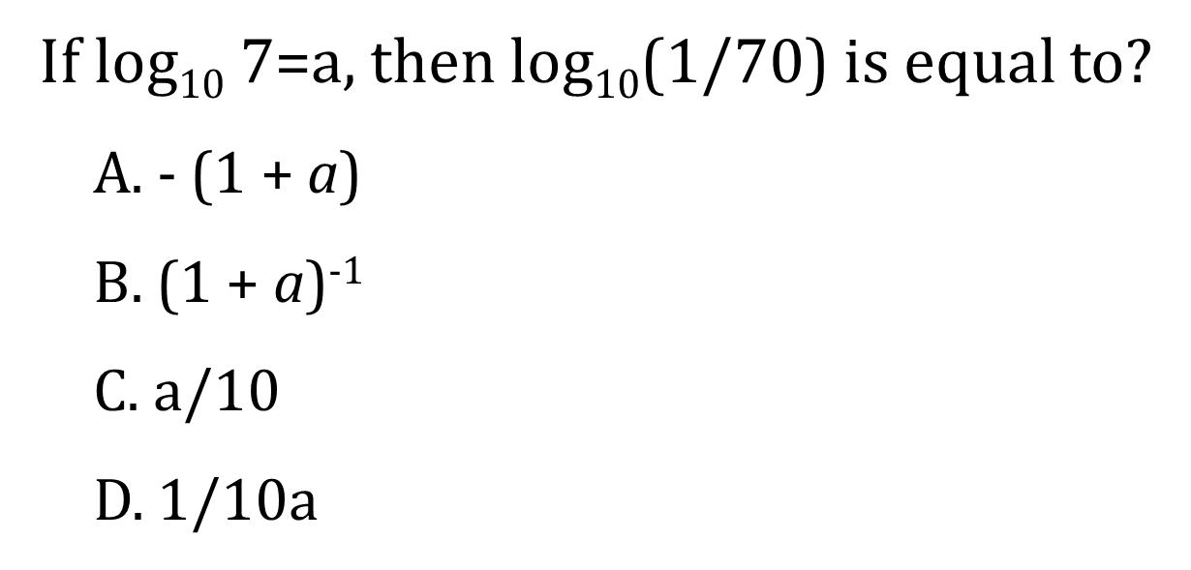
3.
Notes:
Sol : b)

Slide 7
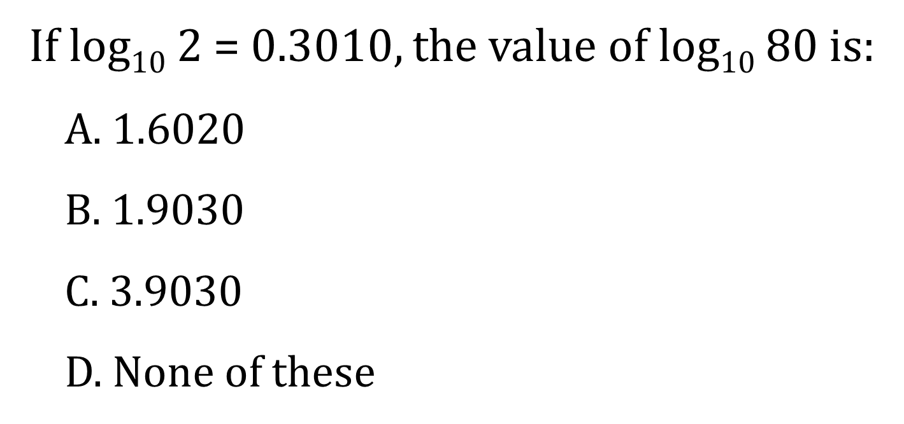
4.
Notes:
Sol : b)

Slide 8
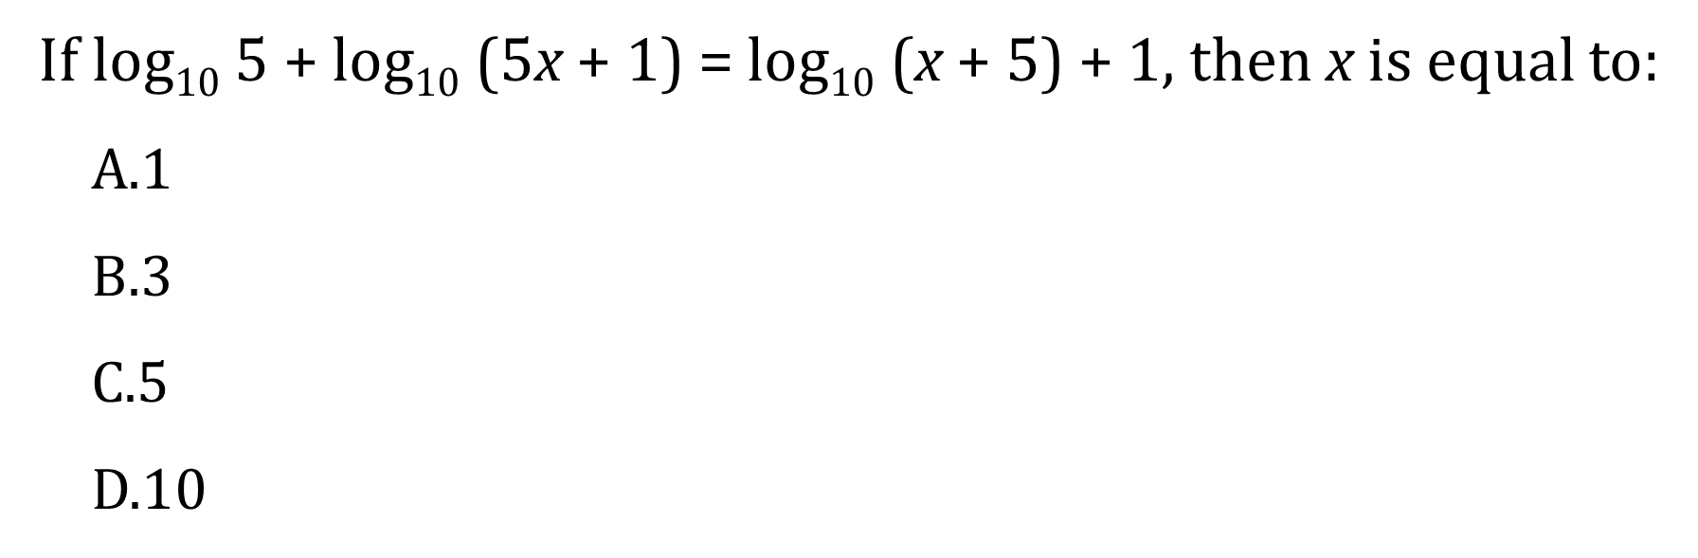
5.
Notes:
Sol : b)

Slide 9
6.If log_{X} (9/16)=-(1/2), then x is equal to,
A.-3/4
B.3/4
C.81/256
D.256/81
Notes:
Sol : b)

Slide 10
7. Find the value of
(1/log₃ 60)+(1/log₄ 60)+(1/log₅ 60)
A.0
B.1
C.5
D.60
Notes:
Sol : c)

Slide 11
8. Find the value of x, if
log (x+5) + log (x-5)=4 log 2 +2 log 3
A.±2
B.±13
C.±12
D.±10
Notes:
Sol : a)

Slide 12
9.Find the value of
2 log(15/18) –log (25/162)+ log (4/9)
A. Log 4
B. Log 15
C. Log 5
D. Log 2
Notes:
Sol : c)

Slide 13

10. Find the value of
log (75/16)- 2log (5/9)+log (32/243)
A. Log 5
B. Log 2
C. Log 3
D. Log 10

Slide 14
THANK YOU

